Slide 1
Unit 3B
Human Form & Function
Body systems
Muscles

Slide 2

Study Guide
Read:
Our Human Species (3rd edtn)
Chapter 4, sections 9-12
Complete:
Human Biological Science Workbook
Topic 12 – The Muscles

Slide 3
Muscle tissue
Muscle tissue consists of highly specialised, elongated cells, which have elastic properties.
Muscle cells get shorter (contract) when stimulated. When the stimulation is removed the cells return to their original shape (relax).
Muscle tissue provides the source of power for movement and posture, and alters the shape and size of internal organs.

Slide 4
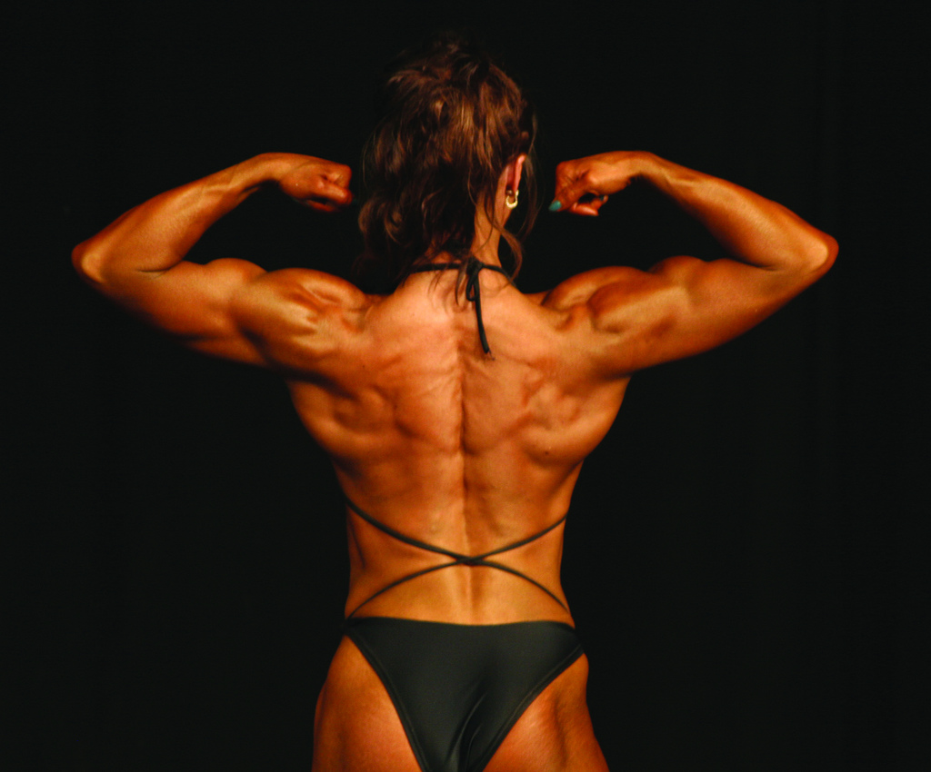
Types of muscle tissue
There are three types of muscle tissue – skeletal, cardiac and smooth muscle.

Slide 5
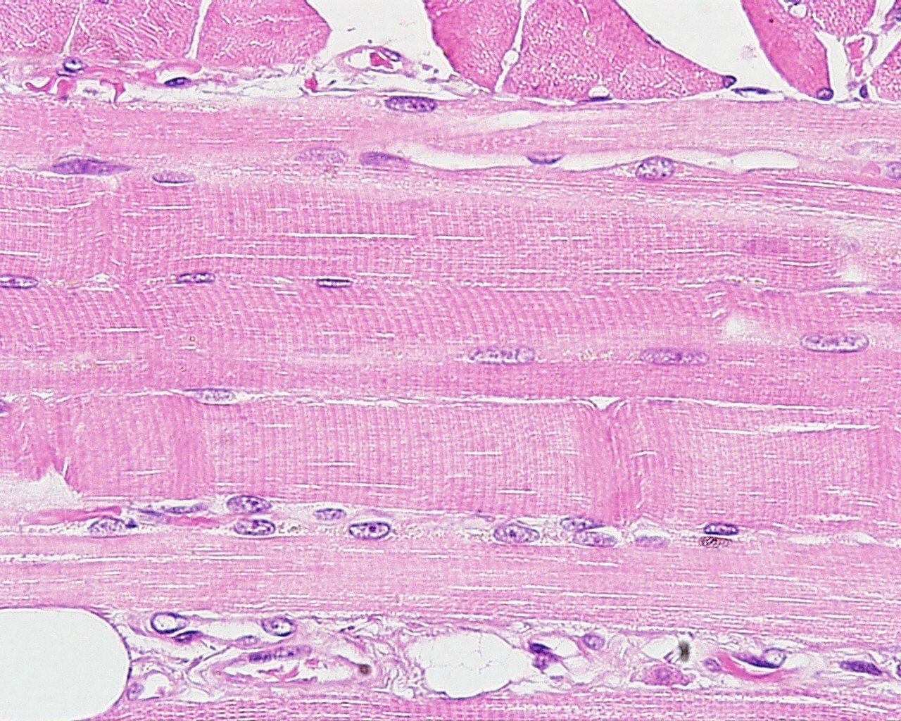
Skeletal muscle
The cells of skeletal muscle are elongated, striated in appearance and have many nuclei.
L Slomianka, ANHB-UWA

Slide 6
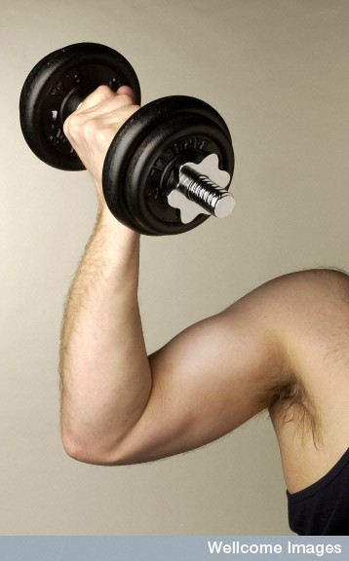
Skeletal muscle - function
Most skeletal muscles are attached to, and move bones of the skeleton. An exception are the facial muscles, which are responsible for facial expression.
Skeletal muscle cells are normally under voluntary control.
Wellcome Library

Slide 7
Cardiac muscle
Cardiac muscle tissue occurs only in the heart.
The cells of cardiac muscle are striated in appearance and form a network of interconnected cells, joining with one another at intercalated discs. They are involuntary.
Cardiac muscle has the special property of being able to relax and contract rhythmically throughout life without becoming tired or stopping.

Slide 8
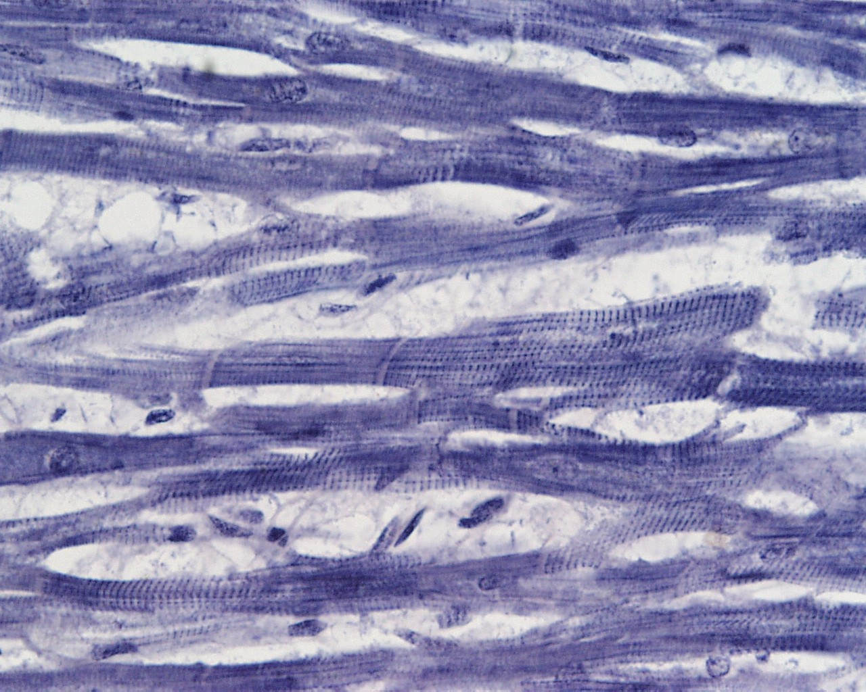
Cardiac muscle
Intercalated disc
L Slomianka, ANHB-UWA

Slide 9
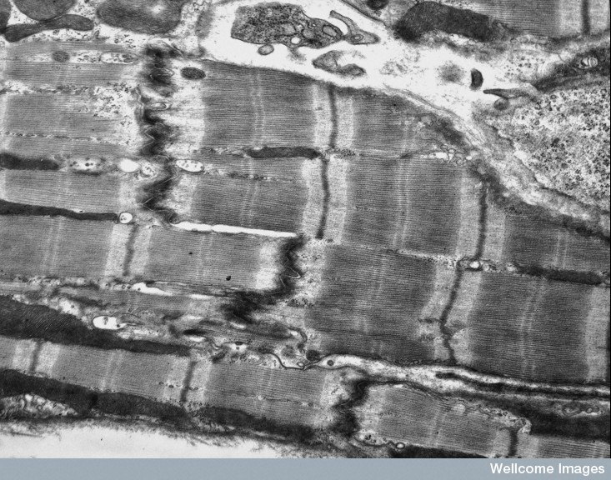
Cardiac muscle
Intercalated disc
Prof Giogio Gabella, Wellcome Images

Slide 10
Smooth muscle
Smooth muscle cells:
are spindle-shaped, contain a single nucleus and are not striated.
either occur in small clusters or form sheets.
are capable of slow, sustained contraction e.g. vasoconstriction, or rhythmical, wave-like contractions e.g. peristalsis.
occur in the walls of many internal organs e.g. blood vessels, the bladder, uterus, male and female reproductive tracts, gut, respiratory tract, intrinsic muscles of the eye .

Slide 11
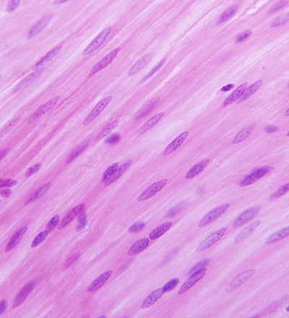
Smooth muscle
G Meyer, ANHB-UWA

Slide 12
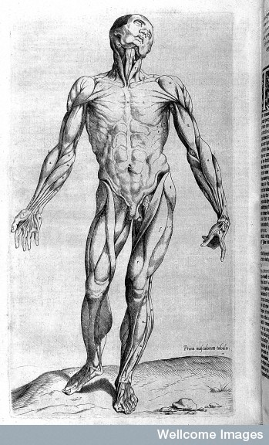
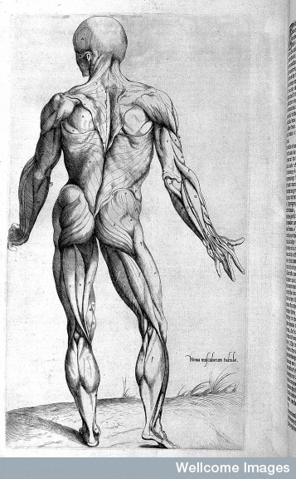
The muscular system
Wellcome Library

Slide 13
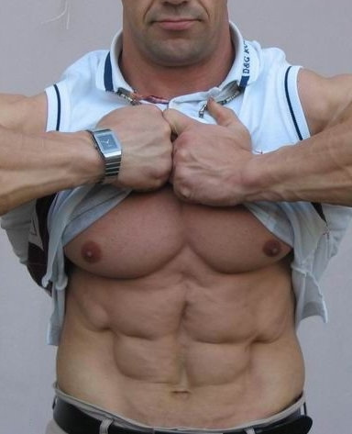
Muscular system
The muscular system consists of all the voluntary skeletal muscles in the body.
The functions of the muscular system are to allow movement, create facial expression, and to maintain posture.

Slide 14
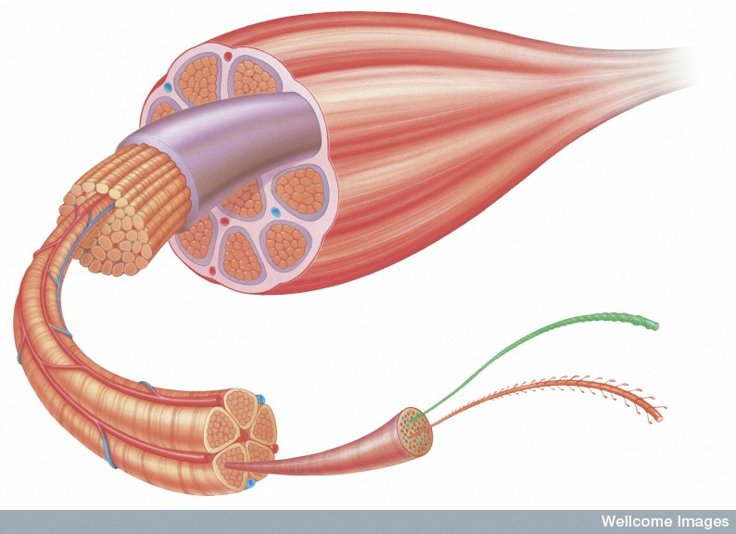
The structure of skeletal muscle - 1
Muscle
Tendon
Muscle cells (muscle fibres) occur in bundles (fascicles) surrounded by a layer of tough connective tissue (perimysium).
Fascicles are bound together by connective tissue to form the skeletal muscles.
Fascicle
Actin & myosin filaments
Muscle
fibre
Myofibril
Miles Kelly Art Library, Wellcome Images

Slide 15
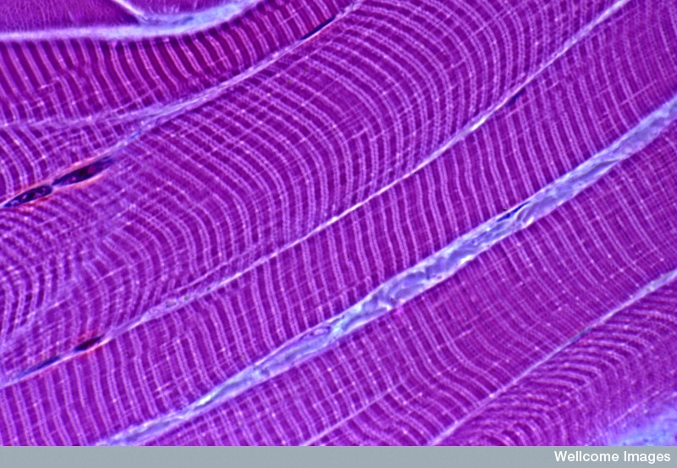
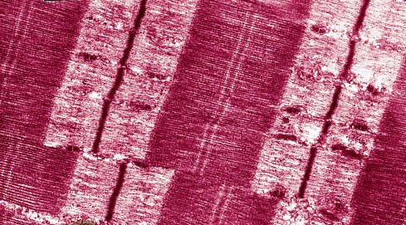
The structure of skeletal muscle
Myofibril
Muscle fibres
Muscle fibers contain numerous contractile cylindrical organelles called myofibrils.
Myofibrils consist of bundles of actomyosin proteins.
M I Walker, Wellcome Images
University of Edinburugh, Wellcome Images

Slide 16
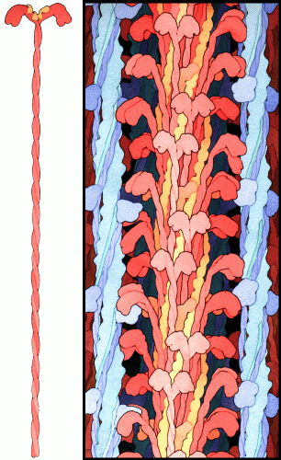
Actin and myosin
Myosin – thick filaments (red)
A single myosin molecule
Actin – thin
filaments (blue)
Muscle cells contain the proteins actin and myosin. These proteins enable the cells to shorten. Because the muscles are anchored to bones this contraction produces movement.

Slide 17
The sliding filament model
Actin
Power stroke
Myosin
Actin
The breakdown of ATP deforms the heads of the myosin molecules. The simultaneous deformation of millions of myosin heads causes the myosin filament to crawl along the actin filament, rather like a ratchet, resulting in the muscle cell getting shorter (contracting).

Slide 18
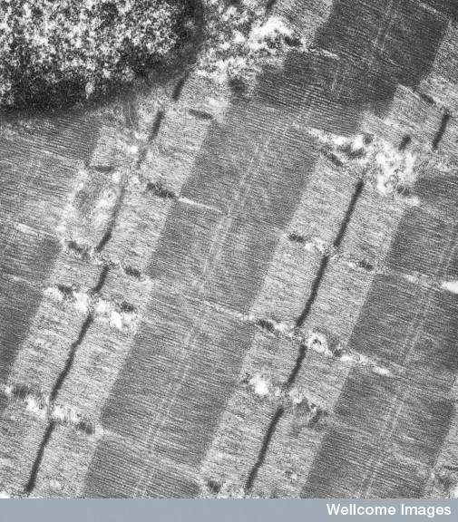
The sarcomere
Light band
gets shorter
during contraction
Myosin filament
Dark
A band
Actin filament
Light
I band
Z
M line
Z line
M
Dark band
Remains same size during contraction
Sarcomere
The alternating dark and light bands of skeletal muscle fibres results from the overlapping bundles of actin and myosin filaments.
University of Edinburugh, Wellcome Images

Slide 19
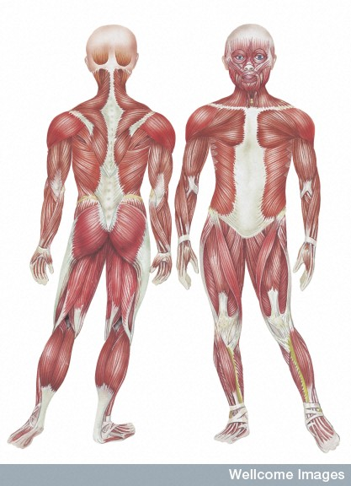
The principal muscles
Trapezius
Trapezius
Deltoid
Pectoralis
Deltoid
Biceps
Triceps
External oblique
Latissimus dorsi
Rectus abdominis
Gluteus maximus
Sartorius
Quadriceps
‘Hamstrings’
Gastrocnemius
Soleus
Miles Kelly Art Library,
Wellcome Images

Slide 20
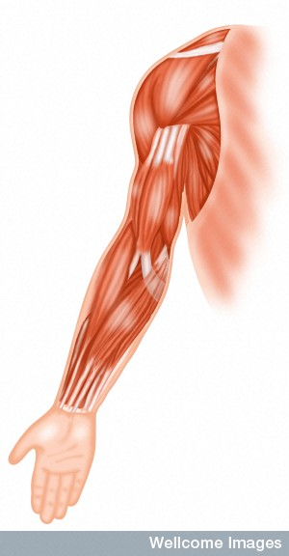
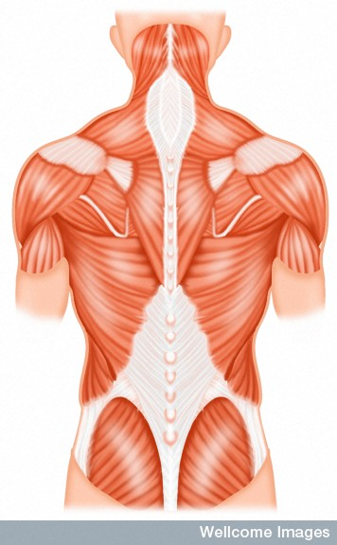
Some muscles are spindle-shaped with a belly (the broadest part) and narrow tendons at either end e.g. the biceps (A).
Others are flat and fan-shaped with a broad band of tendon at one end ( an aponeurosis) converging to a narrow tendon at the other e.g. the trapezius (B) and pectoralis.
Other muscles are feather-like (pennate) or circular (sphincter).
A
B

Slide 21
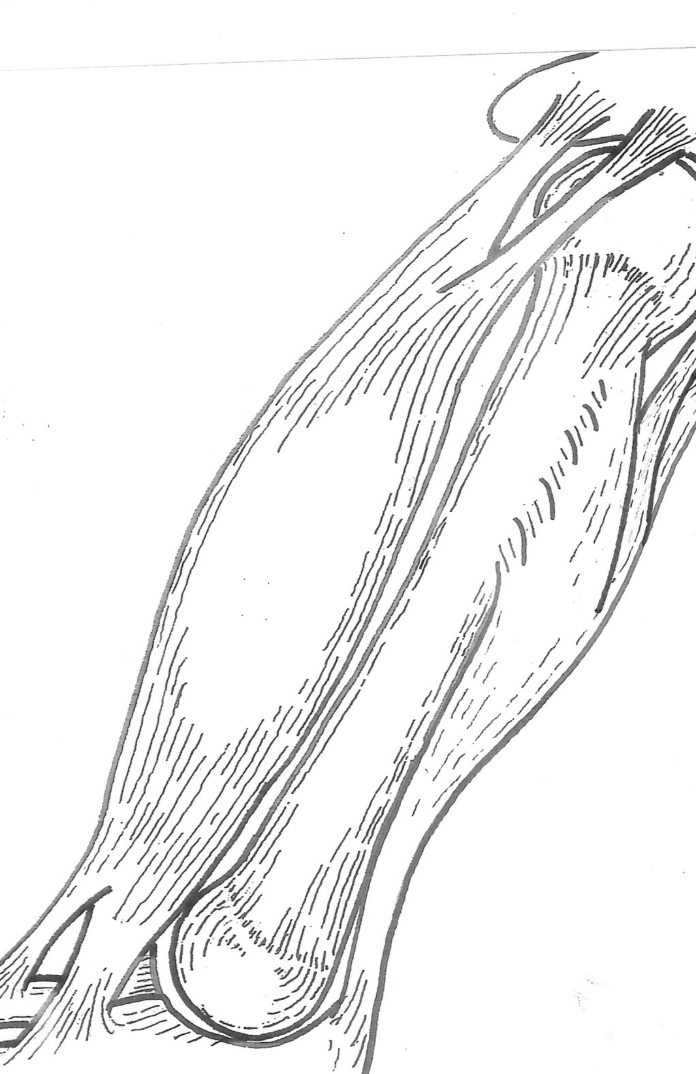
Origin
Most muscles have a fixed end (the origin) and a movable end (the insertion)
Belly (gaster)
Insertion

Slide 22
Antagonistic muscles
Most skeletal muscles work antagonistically in pairs or groups. When the flexor/abductor muscle contracts, the antagonistic extensor/adductor muscle relaxes, and vice versa.
Smaller muscles that assist the primary antagonistic muscles are known as synergists.

Slide 23
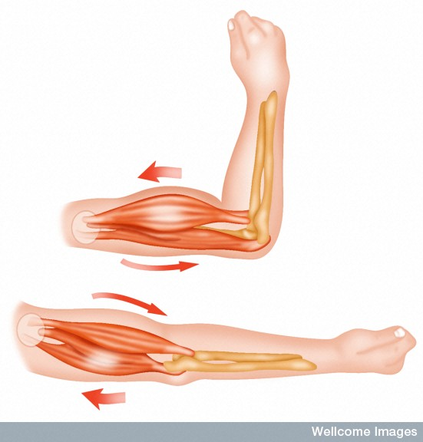
Antagonist muscles
Biceps (Flexor) contracts – triceps (extensor) relaxes
Flexion
Biceps (Flexor) relaxes – triceps (extensor) contracts
Extension
Wellcome Photo Library

